Slide 1

Capstone Project - Spring ‘23

Slide 2
Problem Definition
Getting an internship is vital for computer science students to develop their skills and be well prepared for the workforce. Our project idea is to leverage our knowledge of AWS to create a job board catered to computer science students, where they will be able to easily to find and apply for internships.

Slide 3
User Stories
SP5 – 4 pts – As a developer, I will create a free AWS account so that I can host our project on an EC2 instance.
SP5 – 4 pts – As a developer, I will create an AWS GitHub pipeline and connect it to the Elastic Beanstalk environment so that our hosted project is always up to date.
SP5 - 4 pts - As a developer, I will set up the UI of the app so that the app has a nice design.
SP5 - 4 pts - As a developer, I will create the authenticated users dashboard so that users will be able to manage internship opportunities.
SP6 - 4 pts - As a developer, I will create a Livewire component to implement public list of opportunities so that users can view available opportunities.
SP6 - 4 pts - As a developer, I will set up an email notification system so that users can receive emails with important notifications.​

Slide 4



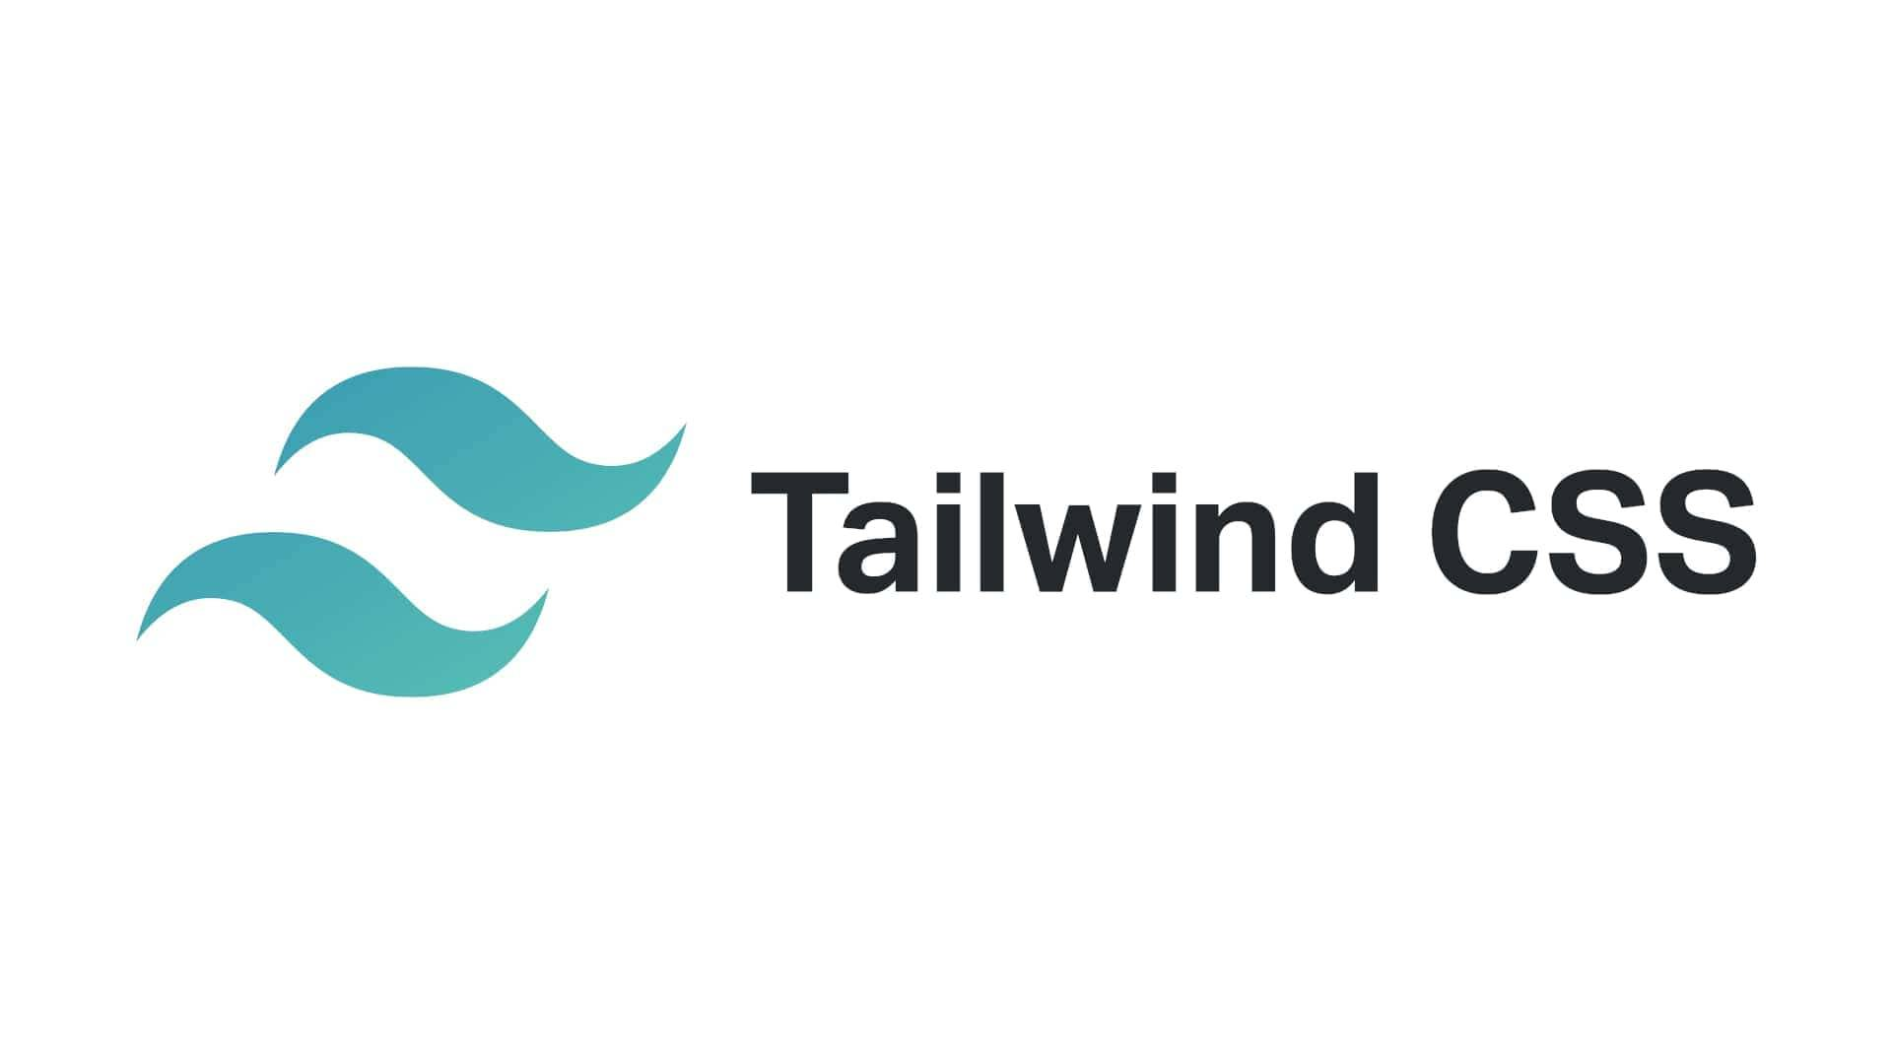

Technologies Used

Slide 5
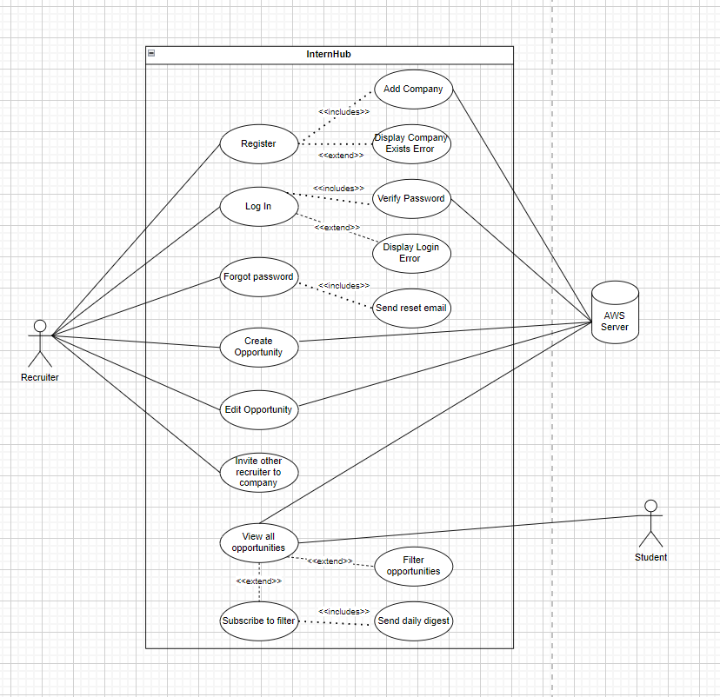
Use Case Diagram
Recruiters can create an account with a company.
If the company is already registered with an account, the recruiter can be invited by a member of the company.
Once registered, they can post opportunities on behalf of the company.
Students can view these listings on the 'All-Opportunities' Page.
Students can also filter through opportunities and subscribe to a daily digest.

Slide 6
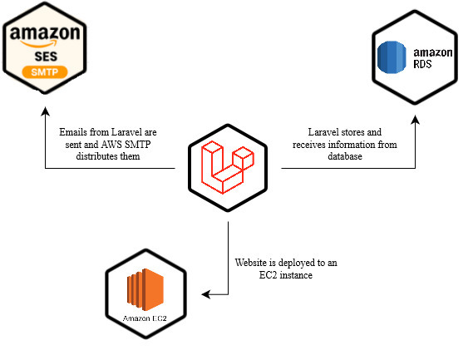
System Design: Architecture

Slide 7
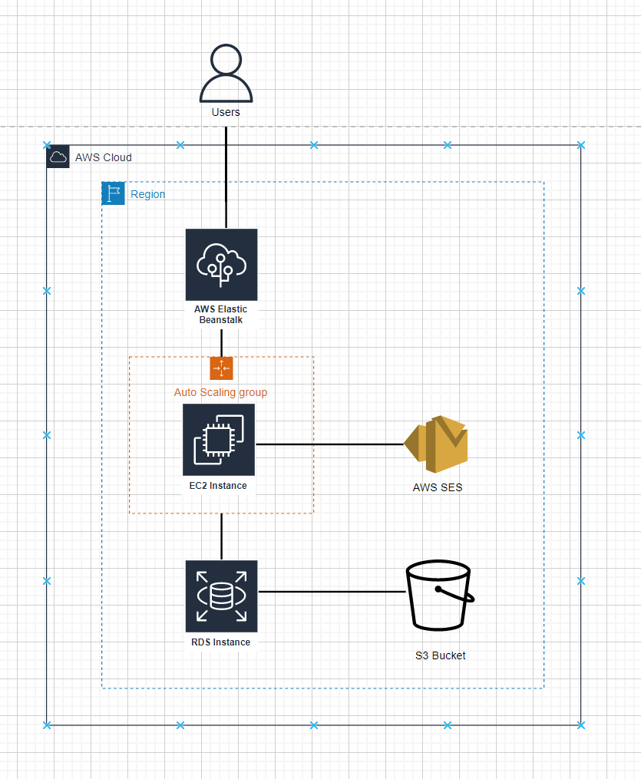
System Design: Deployment
Currently, InternHub is being hosted on an EC2 instance
We leveraged AWS's Elastic Beanstalk to deploy the instance.
Amazon RDS is used as database, where the user accounts and opportunities are held.

Slide 8
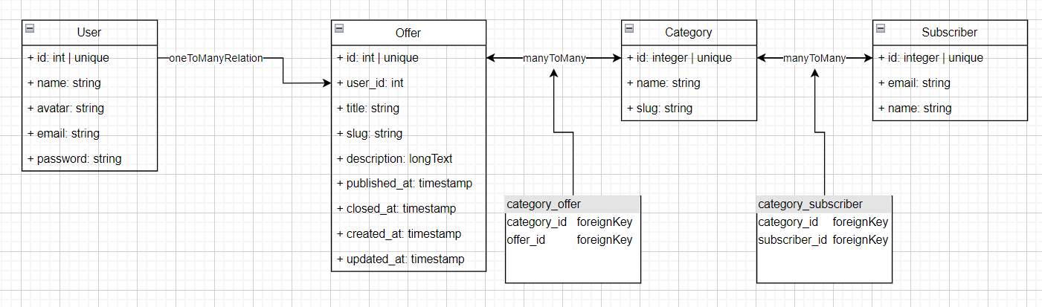
Database Design

Slide 9
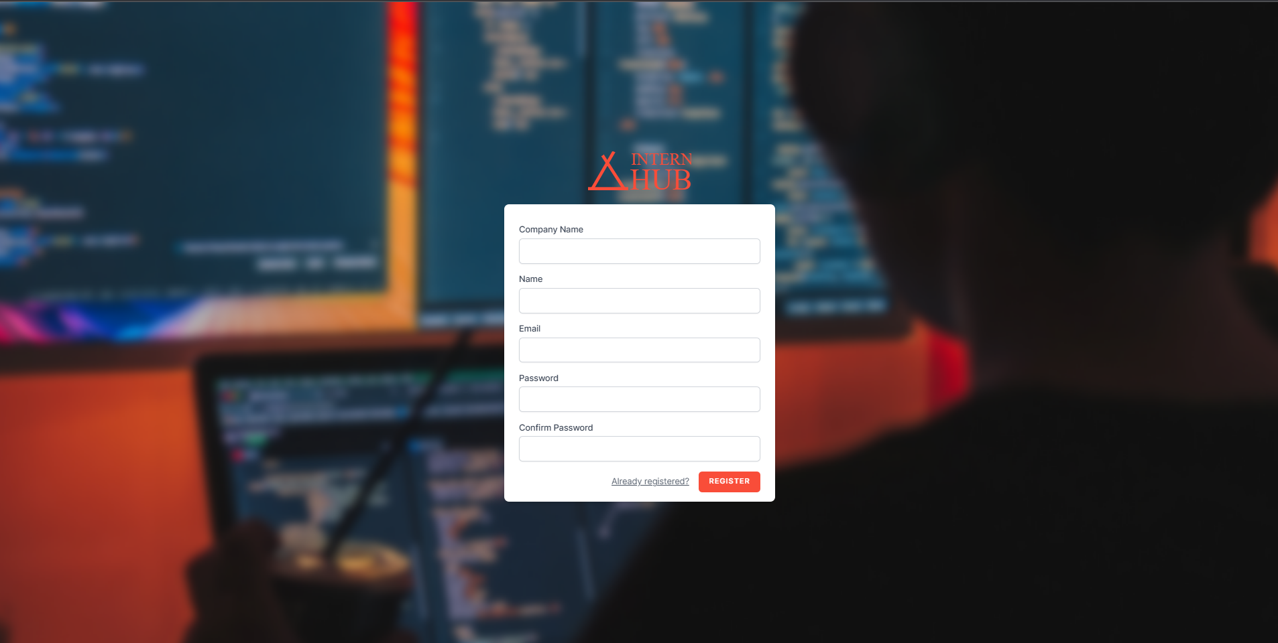

Register and Login Pages
Register page allows recruiters to create an account with a valid email address
Once account is made, recruiters can add others to their company and start creating opportunities
Users have the option to change password in case it is forgotten through login page

Slide 10
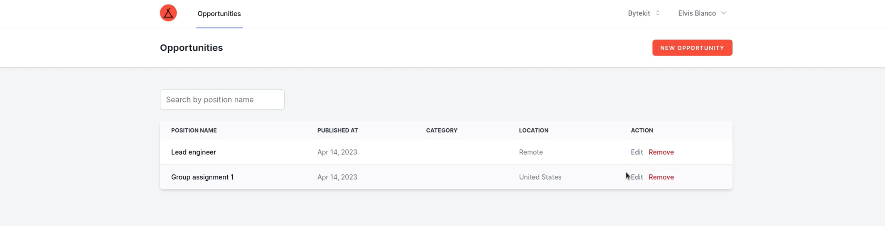
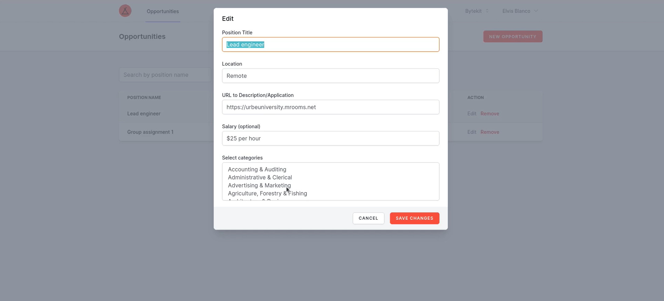
Opportunities Page
Registered users (recruiters) can publish opportunities on behalf of a company on the private Opportunities Page.
Opportunity listings must have a category.
Recruiters can also edit opportunity listings.

Slide 11
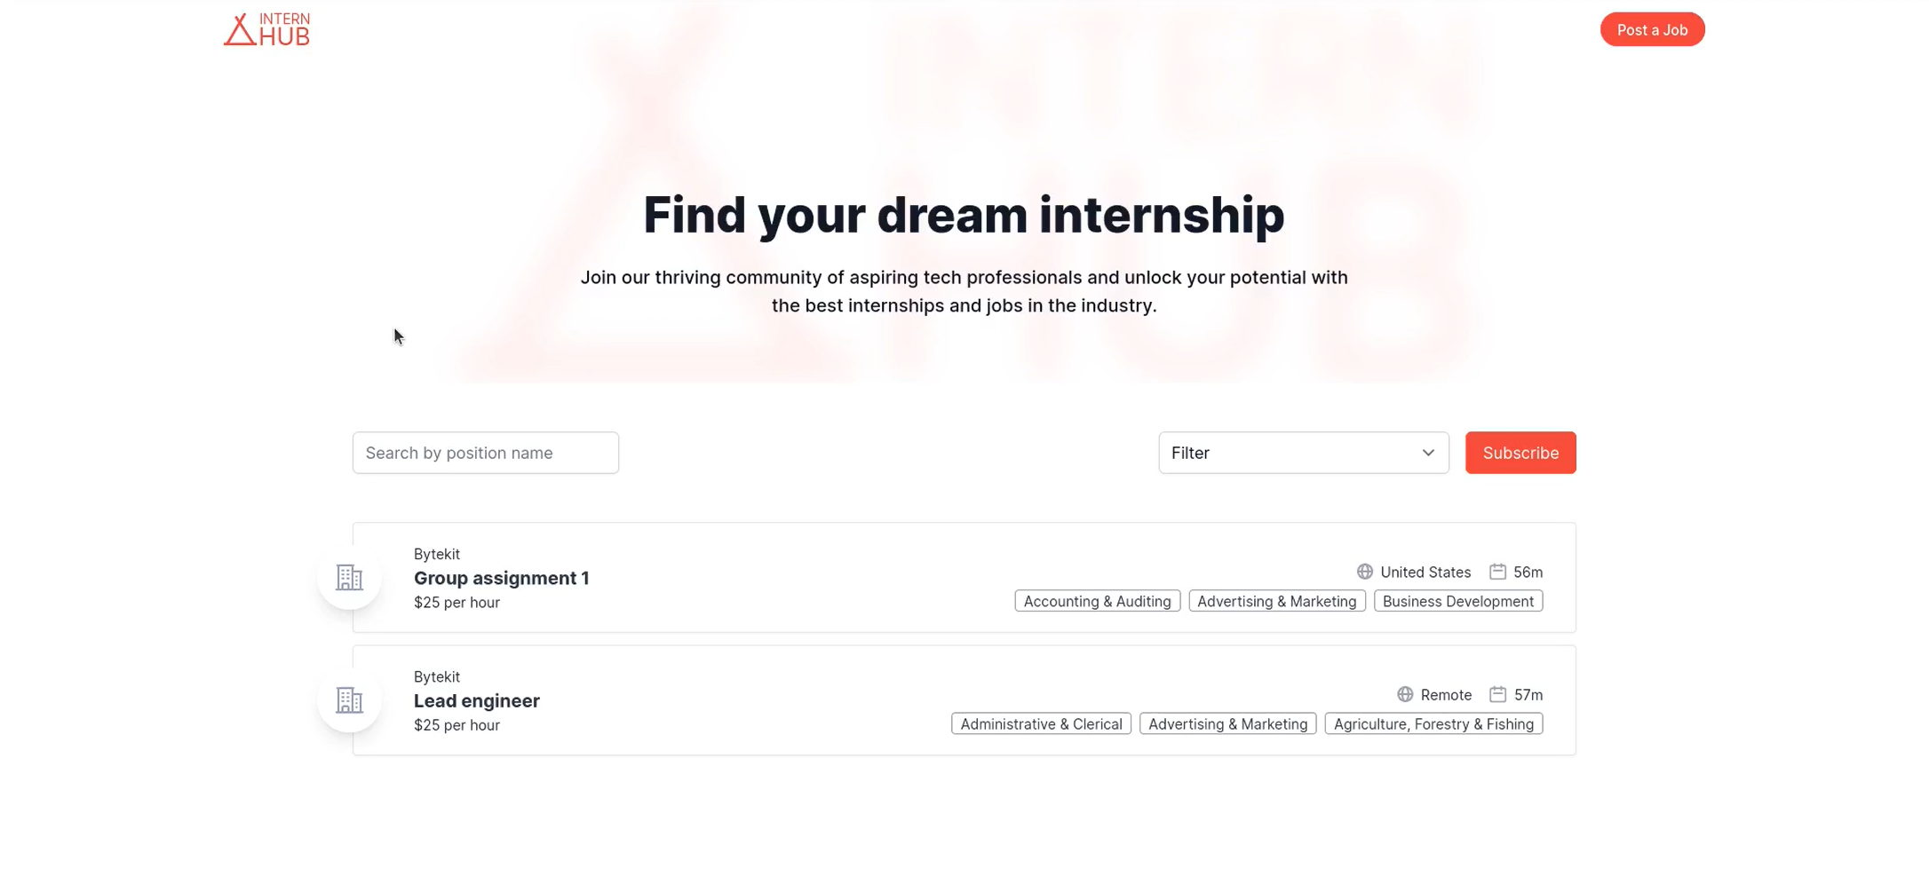
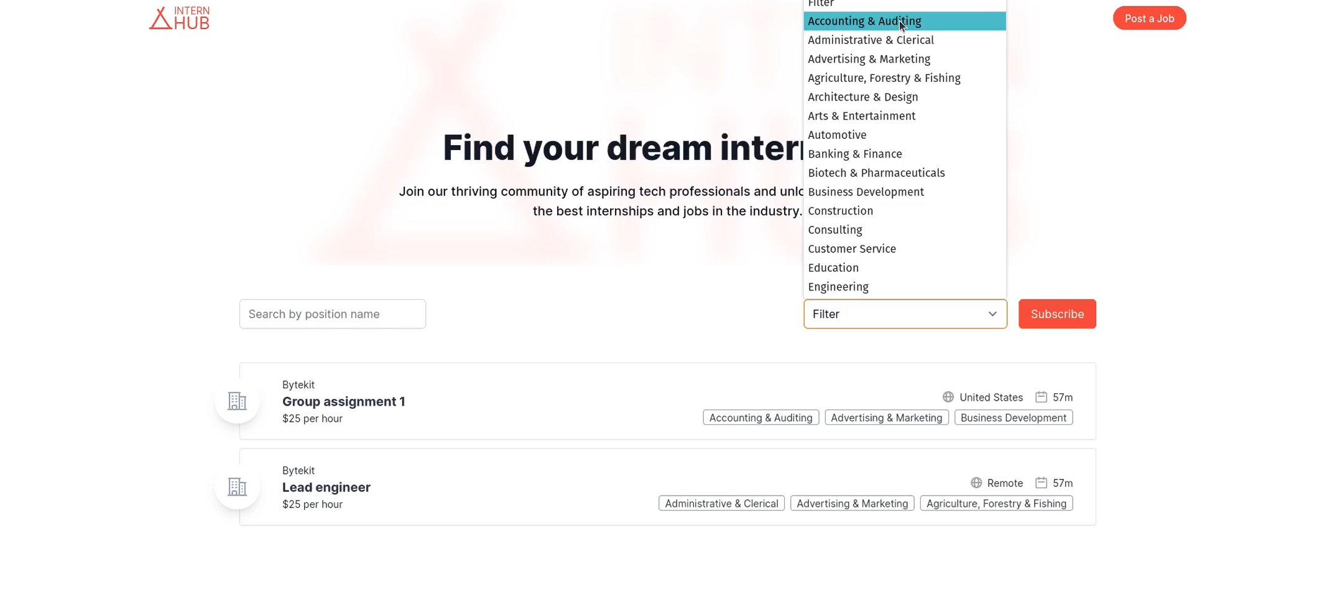
All-Opportunities Page
Unregistered users (students) can navigate through internship listings in the 'All-Opportunities' Page.
Clicking on a listing will redirect the user to the listing site so they can apply.
Filter and search bar can be used to narrow results
Students can also subscribe to a set of filters and receive a daily digest of new opportunities

Slide 12
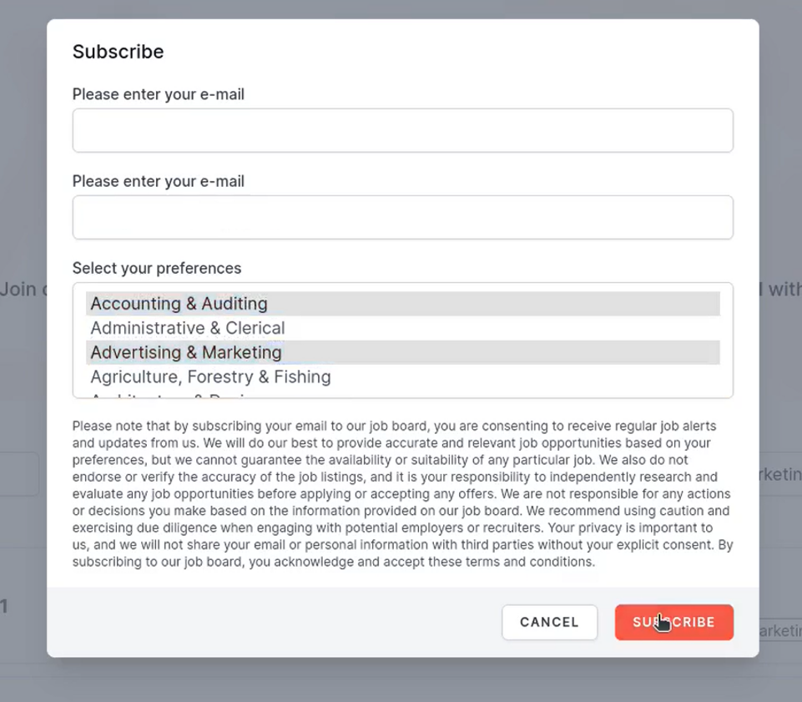
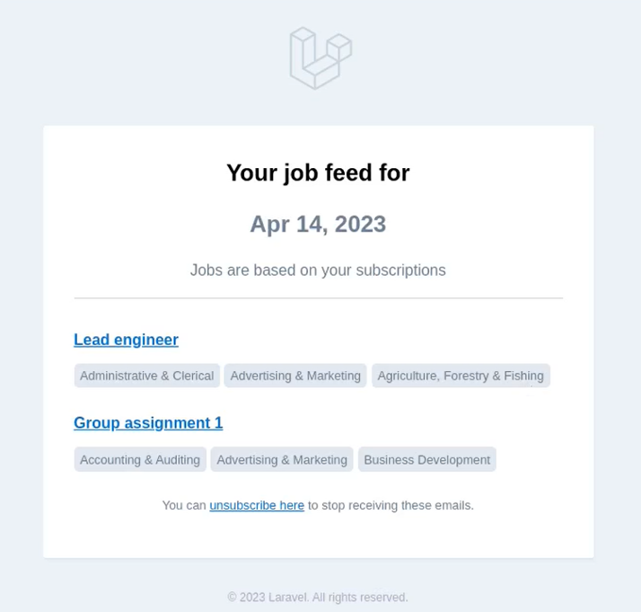
Emailing System

Slide 13
Challenges we faced
Learning about AWS and applying it to a project in a short period of time (time constraints)
Difficulty setting up repository locally on everyone's machines
Issues with local host and routing
Configuring an email system with IAM Roles, Lambda, and SNS was not feasible in the allotted time
Emails were instead implemented using Laravel and AWS SMTP

Slide 14
Conclusions
Designed page layouts and branding for InternHub site.
Successfully implemented Login, Register, and Forgot Password pages.
Created authenticated dashboard where recruiters could post and edit listings.
Set up a public 'Opportunities' page where students could filter through listings based on categories.
Leveraged Laravel and AWS SNS to structure a subscription system with daily email digests.
Applied AWS skills to host site on EC2 instance with Elastic Beanstalk and RDS.

Slide 15

Thank You!

